Slide 1
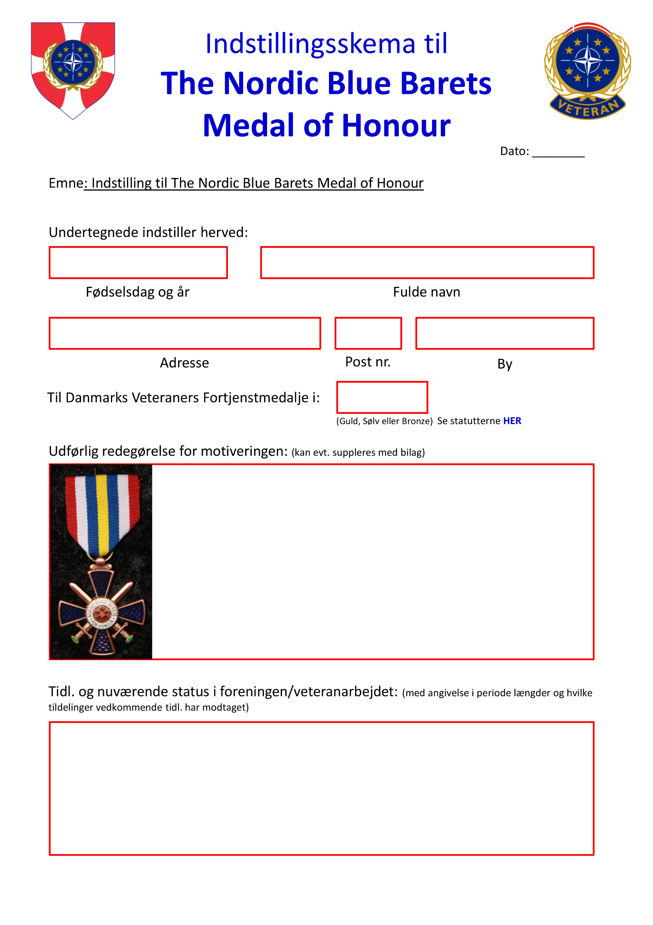
The Nordic Veterans
Medal of Honour
Veterans Medal of Honour
Til The Nordic Veterans Medal of Honour i:

Slide 2
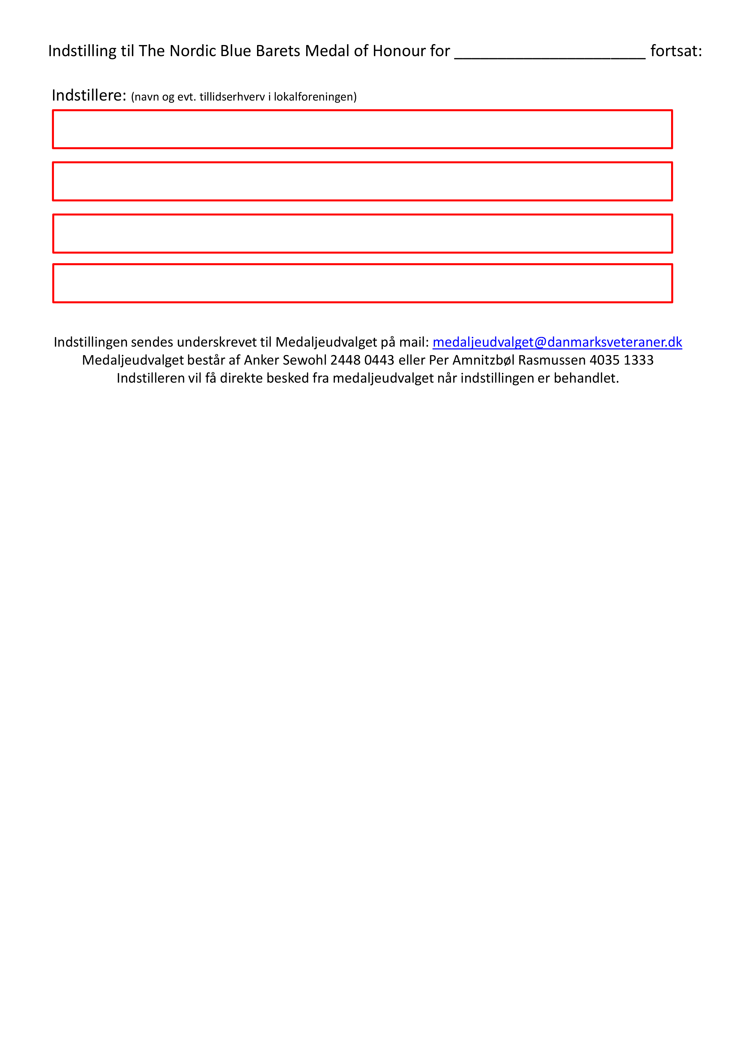
Veterans Medal of Honour for

